Slide 1
Opportunity Zones Nevada
Kaya Bromley, JD/MSW
General Counsel, Community Ventures RE
Founder of the Reno-Sparks OZ Task Force

Slide 2
What Are Opportunity Zones?
Part of 2017 Tax Cuts and Jobs Act
Tim Scott (R-SC)
Cory Booker (D-NJ)
Encourages long-term investment into low-income and rural communities
8,700 Opportunity Zones across the country

Slide 3
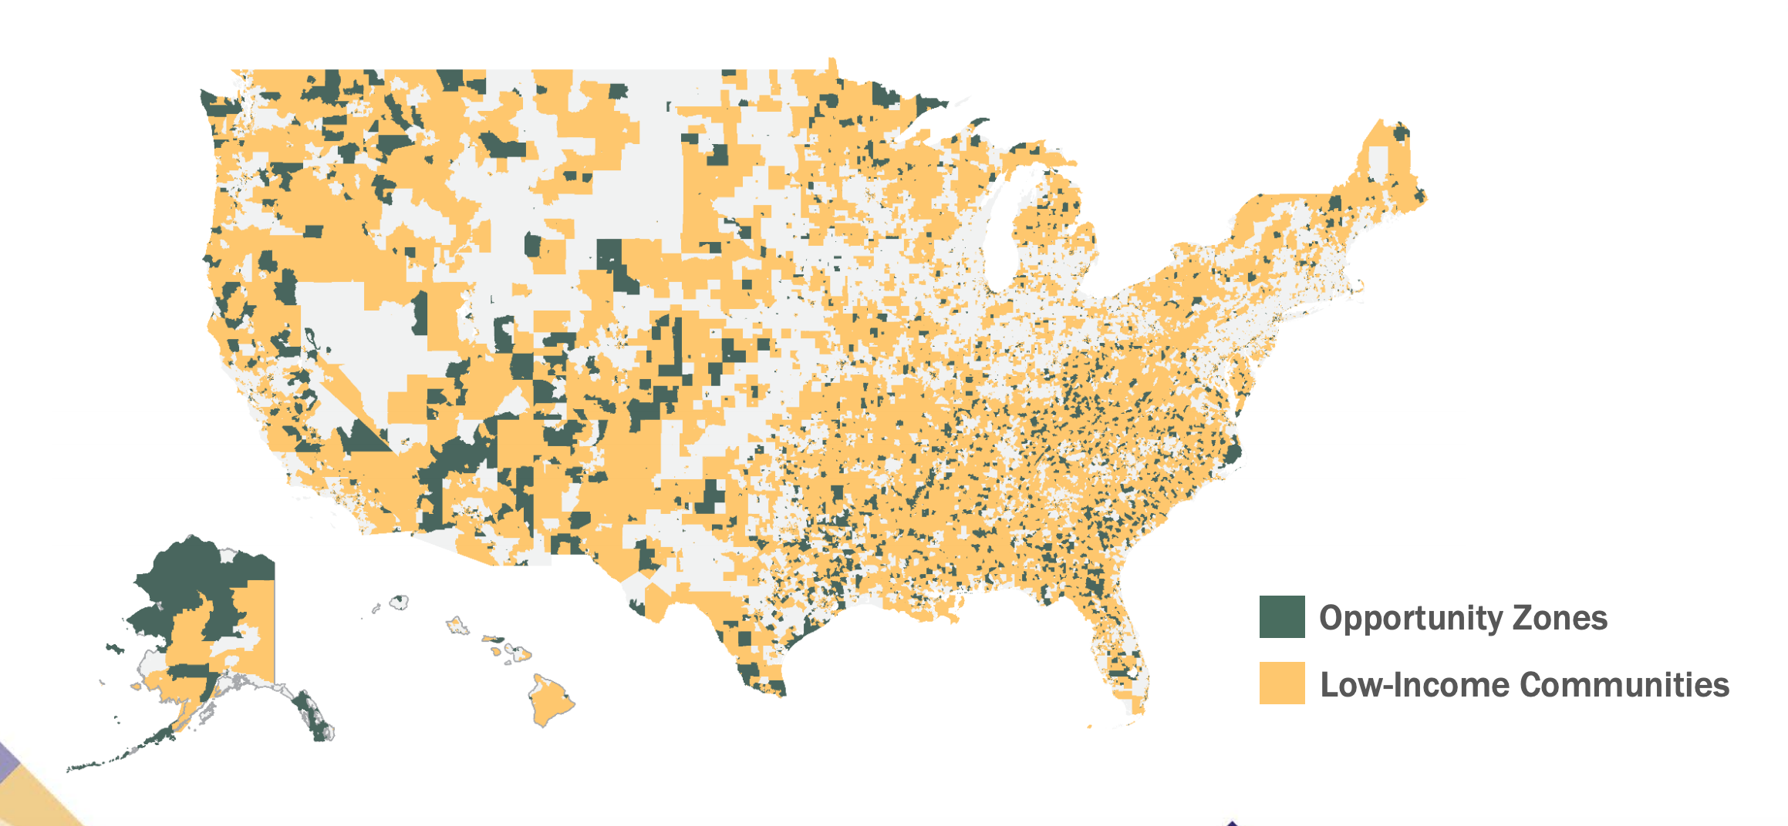
8,700 Opportunity Zones

Slide 4
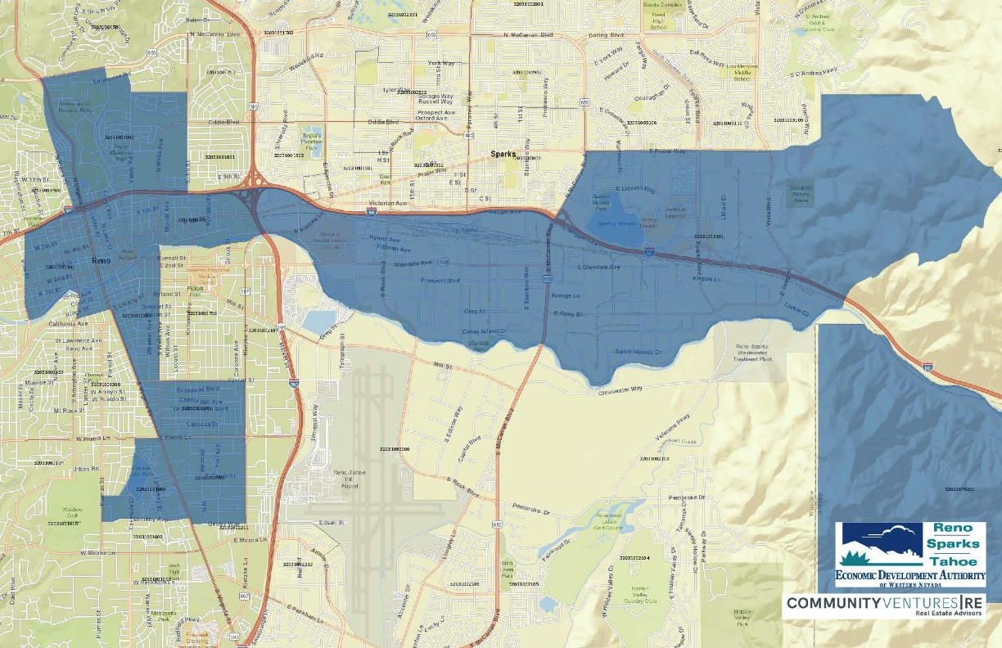
Insert MAP of OZ

Slide 5
Opportunity Zone Program Offers Three Tax Benefits:
Temporary Deferral
Step-Up in Basis
Permanent Exclusion

Slide 6
Investor Realizes a Capital Gain

Slide 7
Example:
Investor bought stock for $1M and sold it for $3M.
Investor has a $2M Capital Gain.
Investor can either:
Pay 23.8% tax on the Capital Gain; or
Invest it in in an Opportunity Zone and receive tax incentives.

Slide 8
Investor Places Gains Into
Qualified OZ Fund within 180 Days

Slide 9
OZ Fund Invests in Real Estate or
Business in OZone

Slide 10
OZ Fund Makes Substantial Improvement
To OZ Business

Slide 11
%
Year
5
Hold 5 Years – 10% Step-Up in Basis
(pay taxes on 90% of cap gains)

Slide 12
%
Year
7
Hold 7 Years – Additional 5% Step-Up in Basis
(pay taxes on 85% of cap gains)

Slide 13
%
Pay Taxes on Original Cap Gains (Less Reductions)
Dec. 31, 2026

Slide 14
%
Year
10
Hold 10 Years
Pay No Capital Gains on Acquired Property

Slide 15
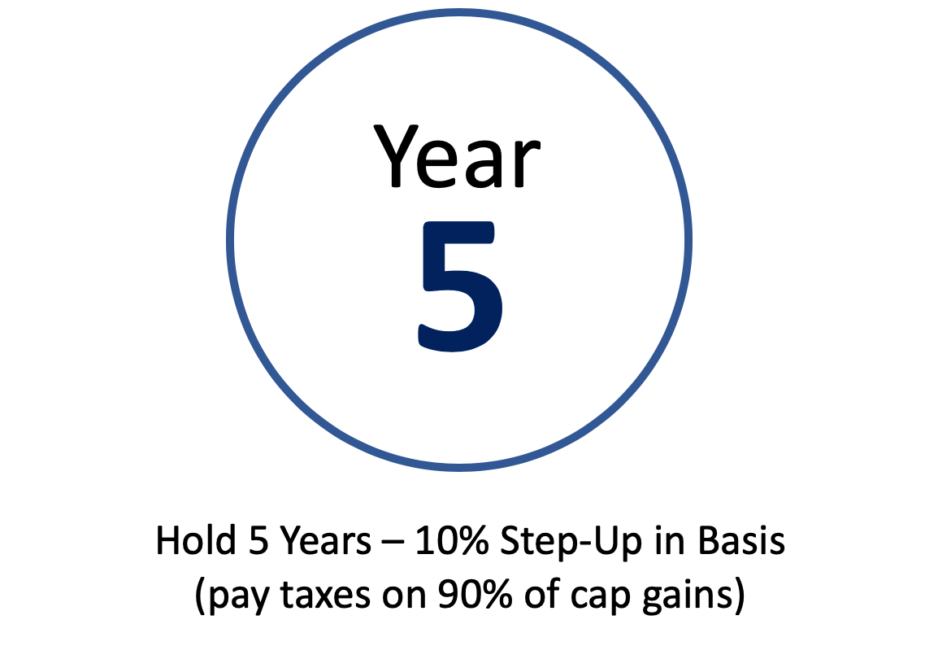
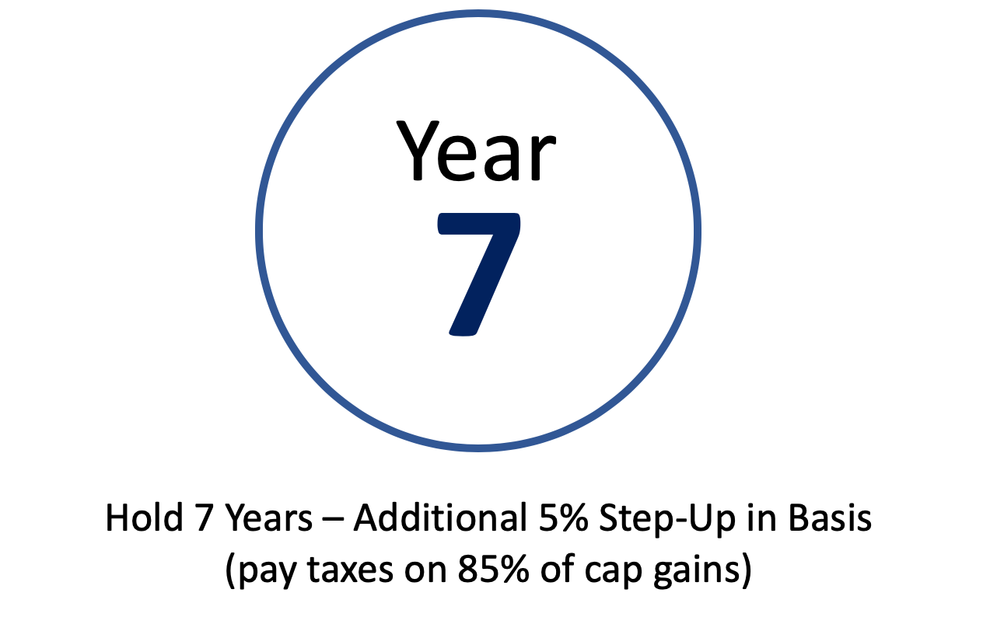
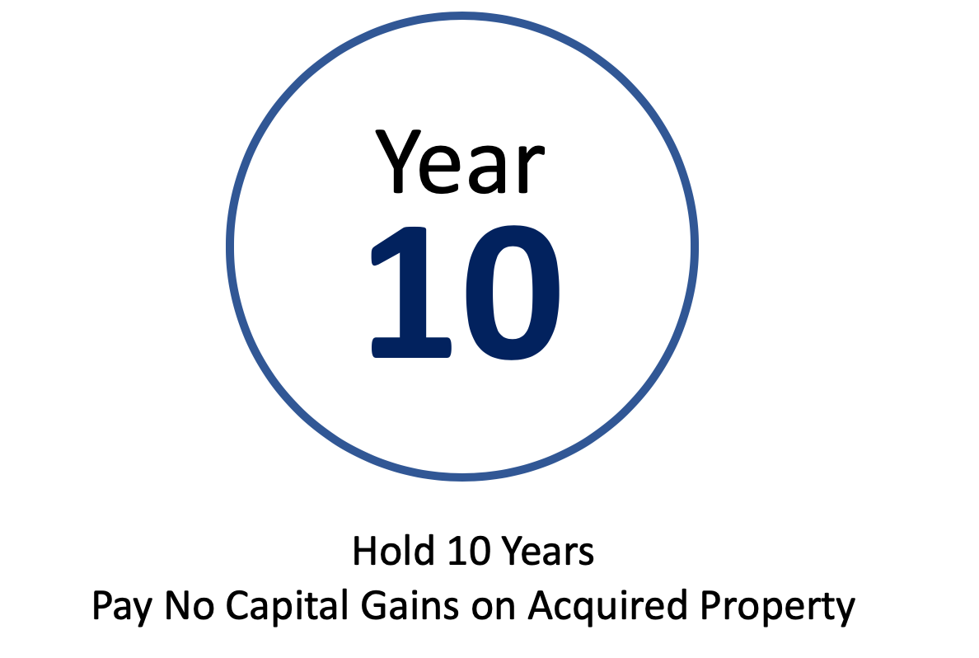
After 5 Years, there is a 10% reduction in Cap Gains
After 7 Years, there is another 5% reduction in Cap Gains
After 10 Years, investor sells investment for $1M and pays Zero Capital Gains upon that sale.
December 31, 2026 – Investor pays deferred capital gains tax less any reductions

Slide 16
Additional Points:
In order to get full 15% reduction of deferred cap gains, investment must be made before end of 2019.
OZ does not make a bad deal a good deal. It still must cash flow.

Slide 17
Reno-Sparks Opportunity Zone Task Force
Northern Nevada Opportunity Zone Summit (February 2019)

